Slide 1
User analysis
Cyclistic
Q1-Q4
2019

Slide 2
Motivating users to
subscribe
Analysed the 2019 Q1-Q4 data to find the underlying trends behind subscriber and customer behavior.
Compared the differences between different user types
Confidential

Slide 3
Reassured data integrity
Cleared corrupt / inconsistent data
Created new metrics like trip duration/ week day
Data Preparation

Slide 4
Key differences
Subscribers
Customers
Who are users with annual subscription
Time
Ride mostly on weekdays
Duration They make more frequent shorter trips
Goal
Commute based usage
Who are users with single ride or daily tickets
Time
Mostly on weekends and in Q2-Q3
Duration Longer trips, recreational usage
Goal
Often from/to tourist locations.

Slide 5
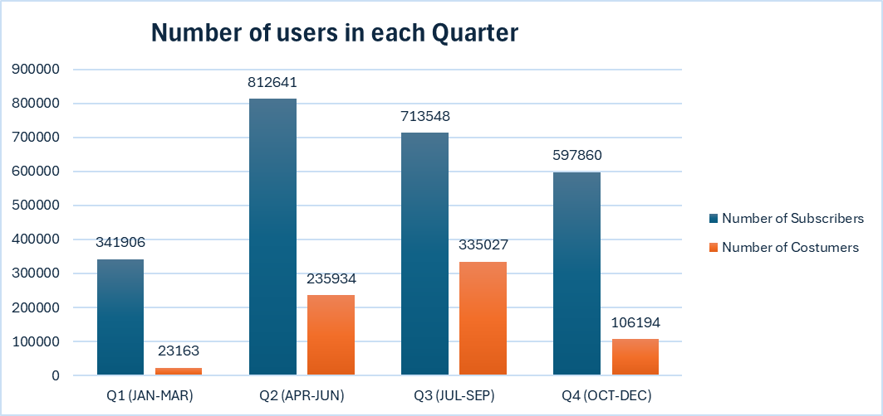
Seasonal Trends
Subscriber usage peaks in Q2 (Spring).
Casual usage peaks in Q3 (Summer).
Summer is the biggest opportunity to convert casuals

Slide 6
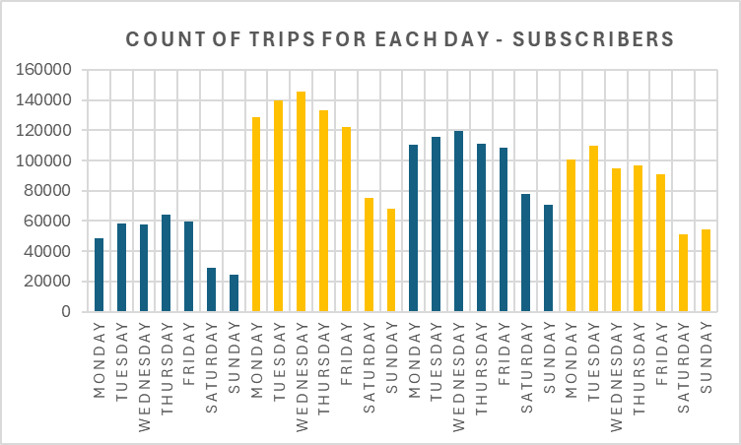
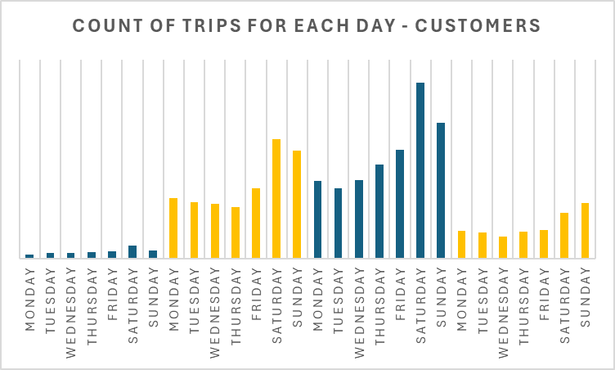
Weekly usage trends
The charts summarise the number of trips for each day in every quarter
Subscribers: High weekday usage (commuting).
Casuals: Peak on weekends (leisure/tourism).

Slide 7
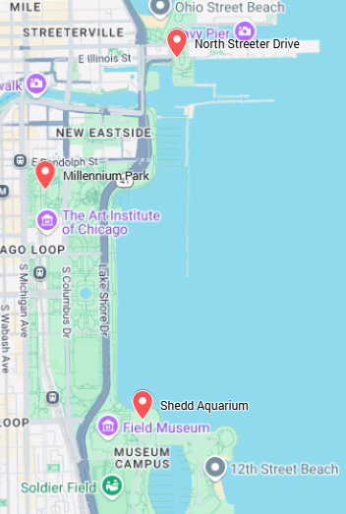
Popular stations for Customers
Millennium Park
Streeter Dr & Grand Ave
Shedd Aquarium
Lakefront attractions

Slide 8
Recommendations
Place
Offers
Benefits
Run targeted promotions at high-casual-traffic stations.
Offer summer discounts or trial memberships.
Promote benefits like unlimited rides, convenience, and cost savings.

Slide 9
Next steps
Step 1
A/B test targeted promotions at top casual rider stations.
Step 2
Use ride history data to segment frequent casuals for upsell campaigns.
Step 3
Monitor conversion rates seasonally.
Confidential

Slide 10
Source File
https://docs.google.com/spreadsheets/d/1rcP6B85QAD_1LWkJBY6YbE4danE1v8bo/edit?usp=sharing&ouid=113187427721165222284&rtpof=true&sd=true

